Slide 1
The Universal Windows Platform
Developer’s guide for
Windows 10 preview
Andy & Jerry

Slide 2
Building a modern, fully-immersive Windows app for the Windows store that targets the common Universal Windows Platform on Windows 10
The definitive developer’s guide for
Windows 10 insider preview
Andy Wigley esquire & Jerry Nixon, developer executive

Slide 3
A single platform
One Windows
Many devices
Developer experience
Windows tooling
.Net Native
Template 10
http://aka.ms/template10

Slide 4

Introducing the UWP

Slide 5
Windows Core
The refactored common core
One hardware platform
Universal hardware driver
Standard network and I/O
Desktop SKU
Phone SKU
Xbox SKU
Windows Core
Desktop
Device
Phone
Device
Xbox
Device
Notes:
Windows core

Slide 6
One Windows
Desktop SKU
Mobile SKU
Xbox SKU
IoT SKU
IoT headless SKU
Surface Hub SKU
Holographic SKU
PC
2 in 1
Tablet
Phablet
Phone
Xbox
Band
Raspberry Pi
Surface Hub
HoloLens
Home Automation

Slide 7
Each family adds features to the one it inherits

Slide 8

The convergence journey
Xbox 360
Xbox One
Unified core and app platform
Converged
OS kernel
Windows 8.1
Windows 8
Converged
app model
Windows 10
Windows Phone 8.1
Windows Phone 8
Easy for users to get & stay current
Windows Phone 7.5
Windows on Devices
Notes:
OS Kernal allowed for multi core etc. But win 8.1 had similar but not identical across. They were using Silverlight which we still don’t really use
Now nirvana with win 10 which is the truly converged dev platform.

Slide 9
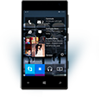

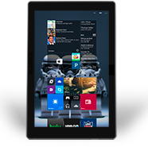
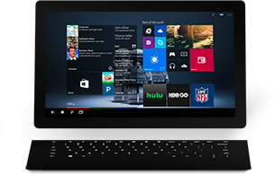

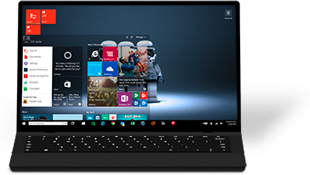

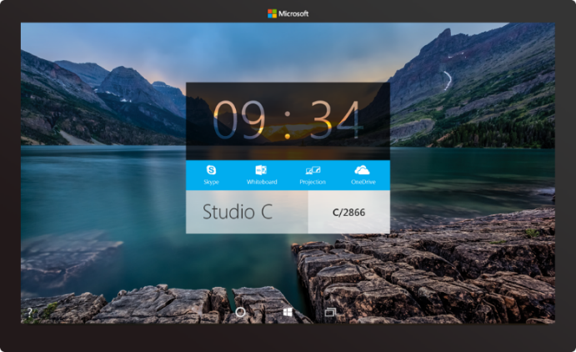

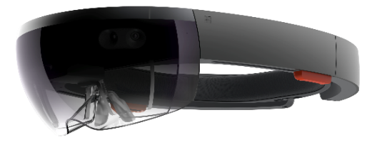



2-in-1s (Tablet or Laptop)
Classic Laptop
Desktops & All-in-Ones
Phone
Phablet
Small Tablet
Large Tablet
Windows 10
Surface Hub
Xbox
Holographic
IoT

Slide 10
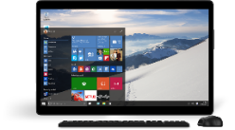
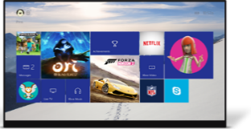
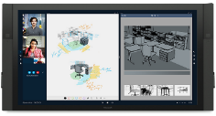
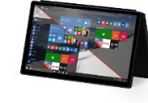
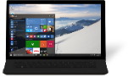
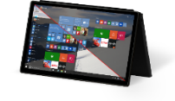
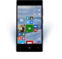
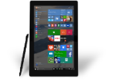
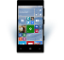











PC
XBox
Mobile
Surface Hub
Devices +IoT
HoloLens
Universal Windows Apps
Multiple device families
Adaptive User Interface
Reuse Existing Code
Natural User Inputs
One Store + One Dev Center
One SDK + Tooling
One Universal Windows Platform
Notes:
Targeting one or more of all these sku’s for each app. Inking can be used acrross all of these devices.

Slide 11
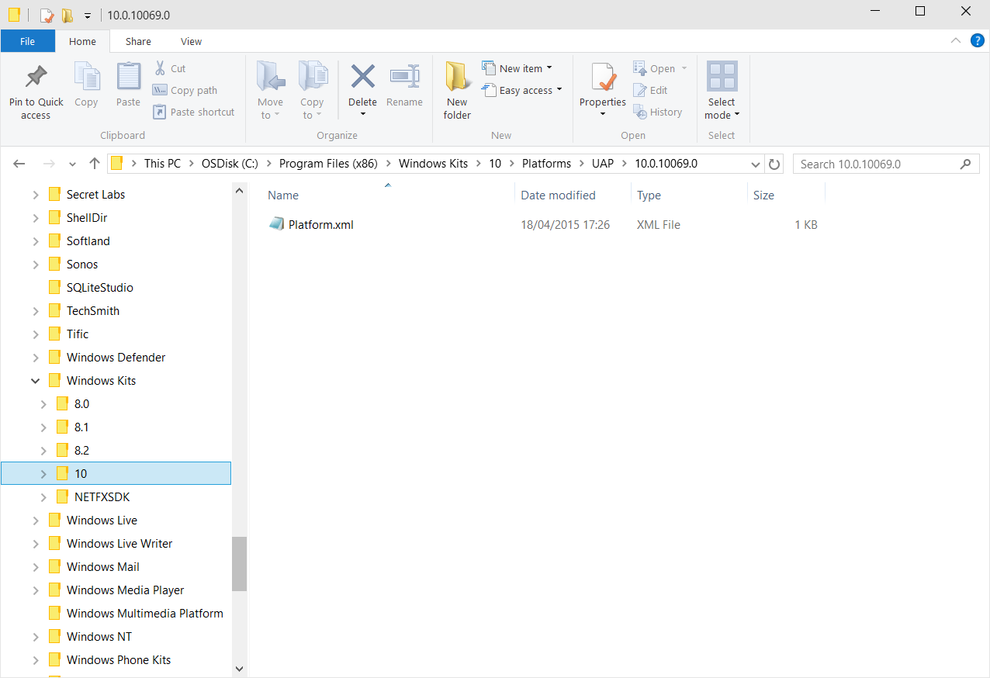
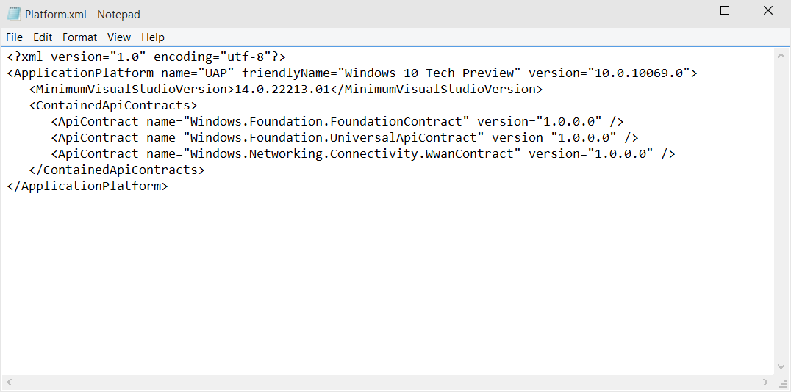
Universal Windows Platform
A single API surface
A guaranteed API surface
The same on all devices
Universal Windows Platform
Windows Core
Desktop
Device
Phone
Device
Xbox
Device
Notes:
UWP is the api that works across all of the device skus. If we have a method call in one it will work across all of the sku’s. These are the same everywhere. This xml file carries the guarantee from Microsoft saying these are available across all devices, trust us. This is really the win RT/phone api’s wrapped up a little differently and added to.

Slide 12
Apps don't target Windows 10, apps target the platform
Notes:
Don’t write apps to target win 8 or phone etc. They now target just the platform and the api’s

Slide 13
<TargetPlatform
Name="Microsoft.Universal"
minVersion="10.0.10069.0"
maxVersionTested="10.0.10190.0"/>
Notes:
Min version- I wrote the app for this
I tested it on this version.
Imagine the store handing this ☺

Slide 14
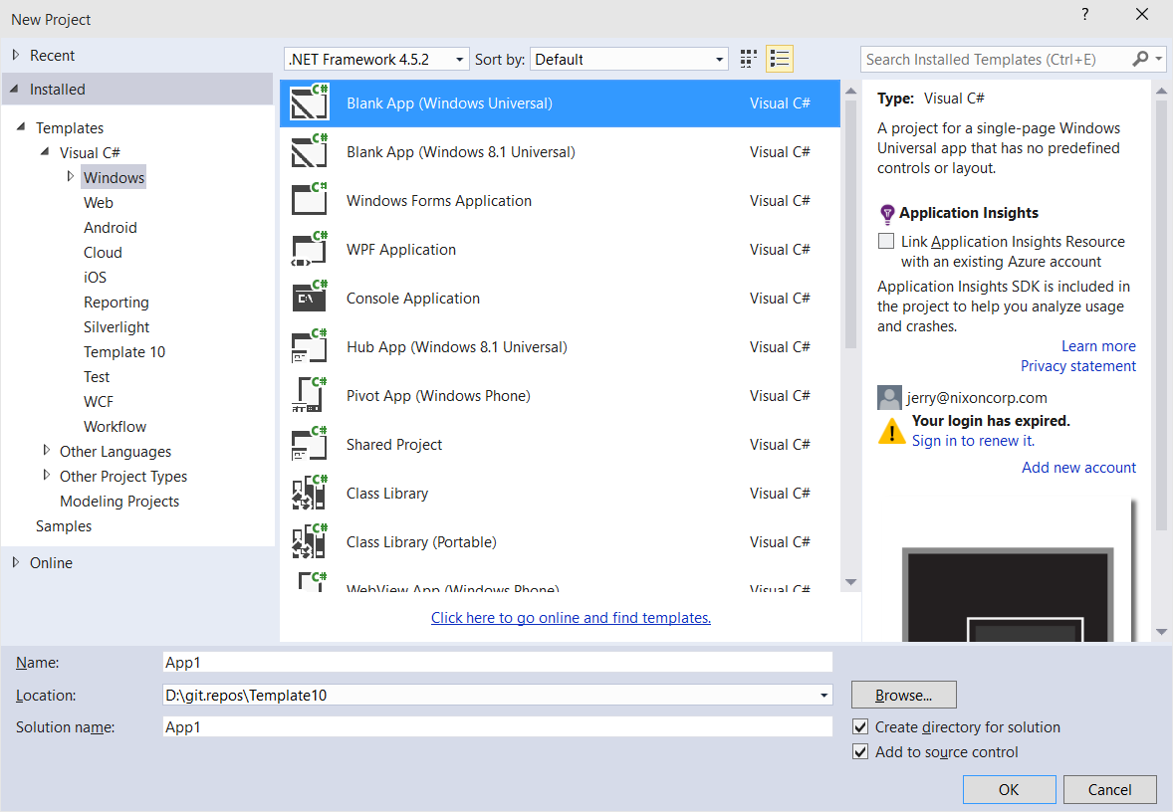
Windows app
A single binary
Running on any device
Testing for capabilities
Adjusting to devices
Windows App
Universal Windows Platform
Windows Core
Desktop
Device
Phone
Device
Xbox
Device
Notes:
Theoretically you could write one app package that would span across all of the devices. Not many use cases but theoretically you could do this… You can constrain it down to the devices that make sense for your app. Obviously.

Slide 15
The developer story
When writing for iOS,
A developer writes for iPad & iPhone
When writing for Android,
A developer writes for all supported devices
When writing for Windows 8,
A developer writes for each devices
When writing for Windows 10,
A developer writes for every device

Slide 16
Hello devices
2:05
Notes:
This shows off blend demo. I think Kat is going to cover this.

Slide 17
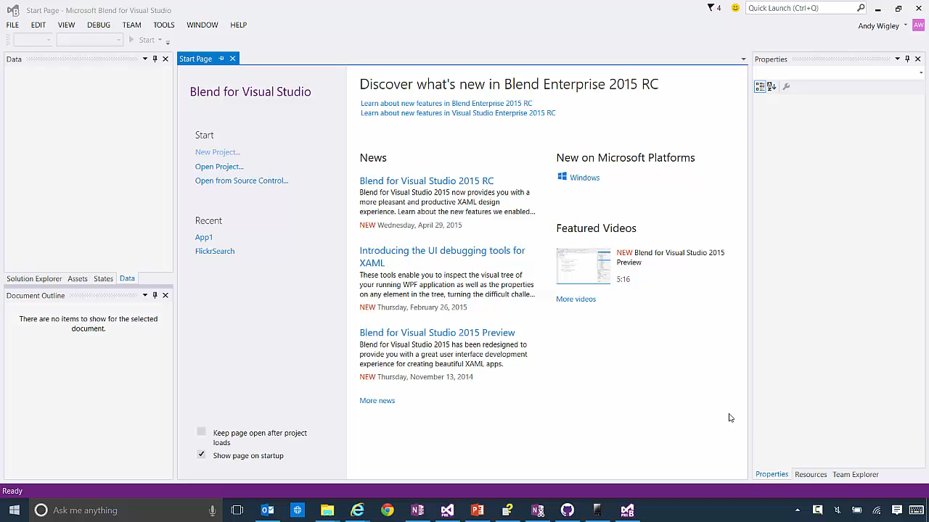

Slide 18
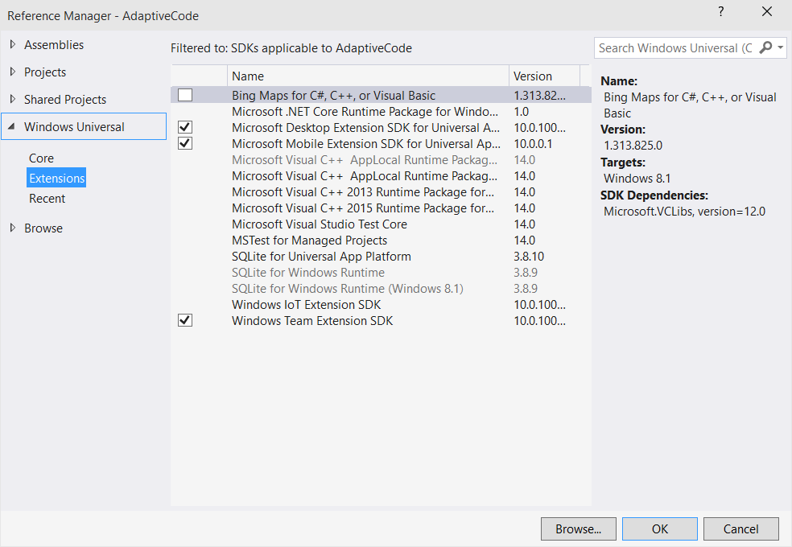
Platform extensions
Device-specific API
Family-specific capabilities
Compatible across devices
Unique update cadence
Windows App
Desktop
extension
Phone
extension
Xbox
extension
Universal Windows Platform
Windows Core
Desktop
Device
Phone
Device
Xbox
Device

Slide 19
Extensions don't invalidate binaries on other devices

Slide 20
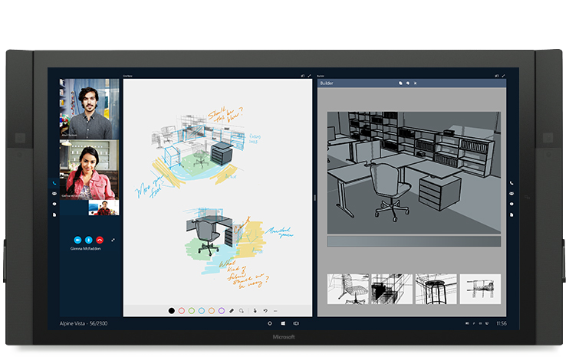
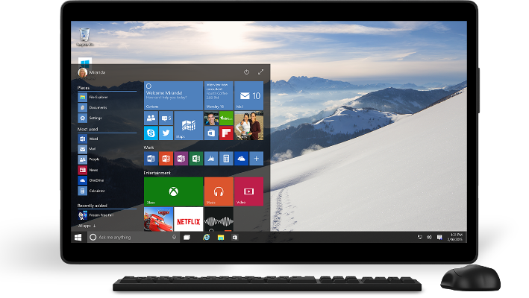
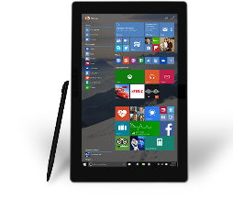

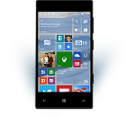
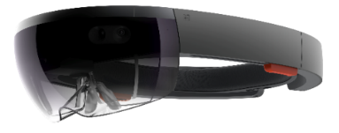
Universal Windows Platform
One Operating System
One Windows core for all devices
One App Platform
Apps run across every family
One Dev Center
Single submission flow and dashboard
One Store
Global reach, local monetization Consumers, Business & Education
Notes:
Dev enters are separate for win 8 and win phone. MSDN has now been converged as well.

Slide 21
Traditional Microsoft technologies are not the only way to create Windows apps

Slide 22
WPF
WF
MFC
XAML
HTML
Bridging technologies
Obj.C
iOS
Java
Android
Web
hosted
Win32
desktop
DirectX
.Net
languages
C++
.Net
languages
C++
& CX
WWA
.Net
runtime
Universal Windows Platform
Windows 10
operating system

Slide 23
Let’s talk about bridge technologies
Objective-C
At Build we announced iOS code can be reused in a Windows app
Android
At Build we announced Android code can be reused in a Windows app to run on Windows Phone
Web
At Build we announced web sites can be wrapped to run on Windows
Win32
At Build we announced that Classic Windows Apps (CWA) can be packaged as an Appx

Slide 24
Bridges bring more apps to the Windows platform

Slide 25
Adaptive design
Responsive design
Flexible layout responds to small changes
Many controls handle basic responsiveness
Adaptive design
Smart layout adjusts to large changes
Features like visual states aid in this design
Tailored design
A device-specific app can simplify design
Some devices have unique design languages

Slide 26
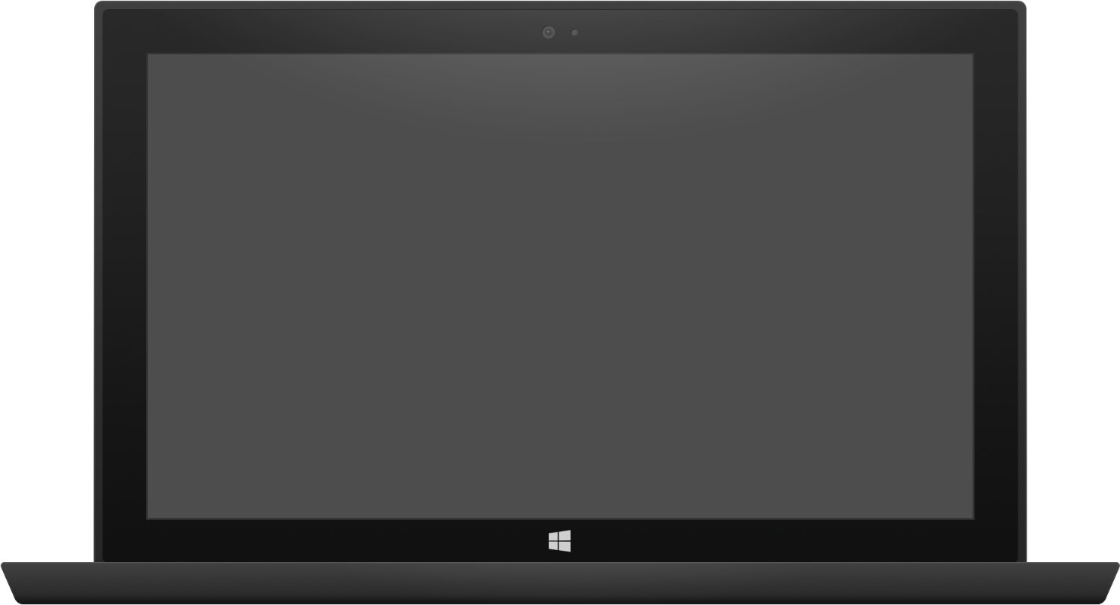

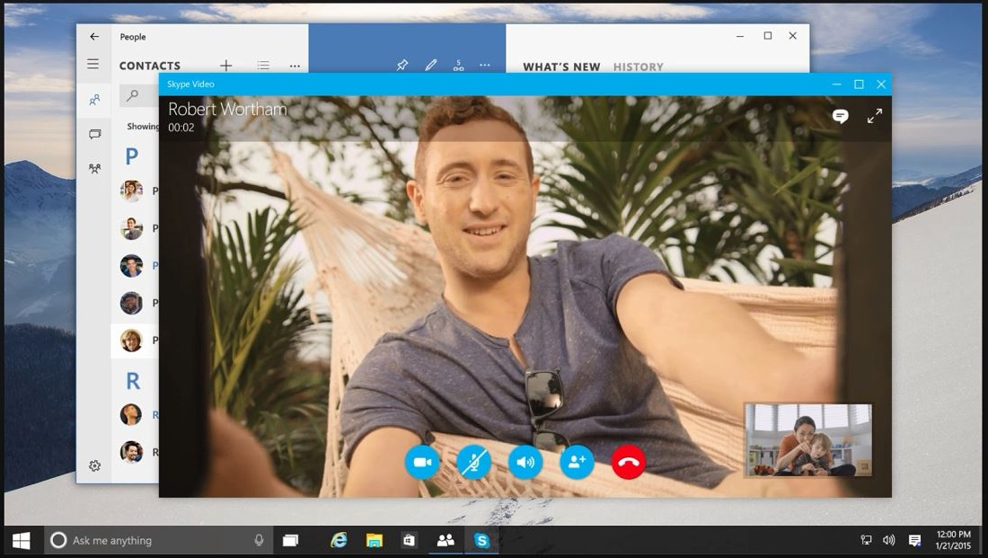
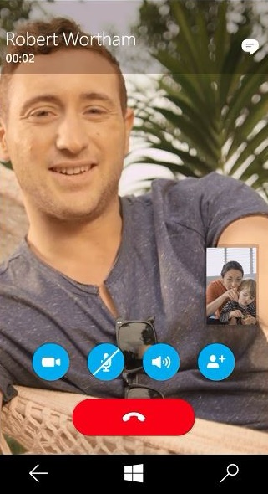
Adaptive design
Tablet (landscape) / Desktop
Phone (portrait)

Slide 27
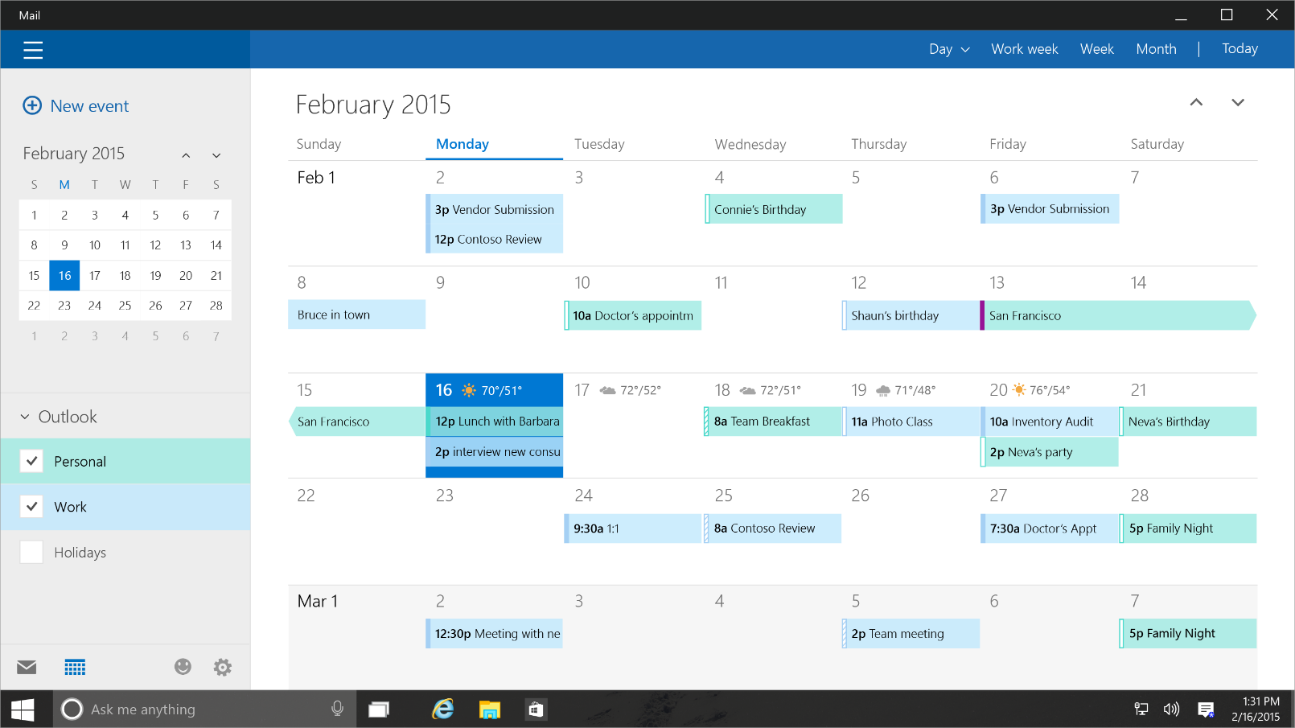
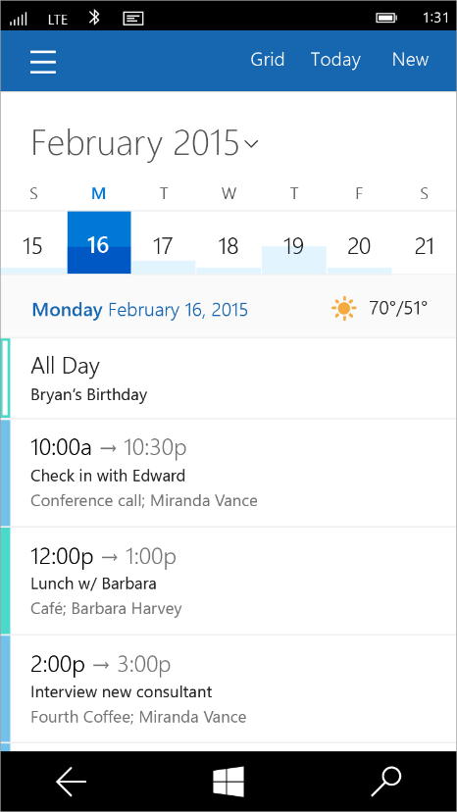
Tailored design
Tablet (landscape) / Desktop
Phone (portrait)

Slide 28
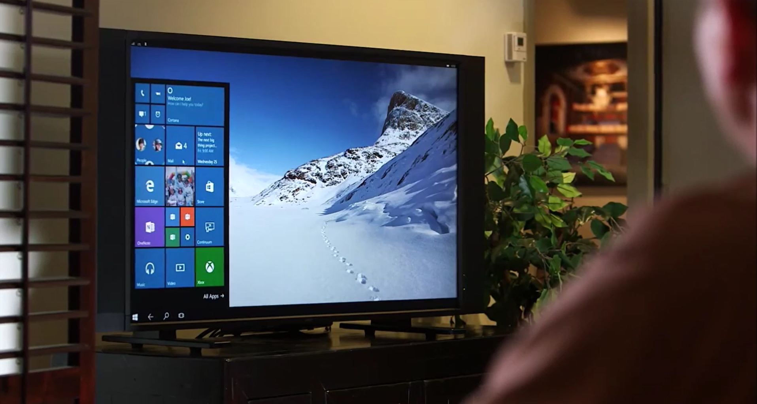
Continuum for Convertibles and Phones
Continuum for convertibles and Phones

Slide 29
Adaptive code
A compatible binary across devices
Universal API with device-specific implementation
Light up our app with capabilities
Testing for capabilities and namespaces

Slide 30
Users love apps that work great on all their devices

Slide 31
Test capabilities at runtime
Use Adaptive Code to light-up your app on specific devices
var api = "Windows.Phone.UI.Input.HardwareButtons";
if (Windows.Foundation.Metadata.ApiInformation.IsTypePresent(api))
{
Windows.Phone.UI.Input.HardwareButtons.CameraPressed += CameraButtonPressed;
}

Slide 32
UAP
UAP
UAP
UAP
Windows Core
Windows Core
Windows Core
Windows Core
Desktop
Mobile
Xbox
More…

Slide 33
The device families you choose determines which APIs you can call freely

Slide 34
One simple, unified, integrated development environment

Slide 35
Visual Studio IDE
Every project type
Desktop, Windows, Phone, Service, Web, Game, More…
Every developer task
Code edit, Architecture design, UX design, Debug, Profile, Review, Test, More…
Every development language
C++/CX, C#, Visual Basic, JavaScript, XAML, HTML, More…
Visual Studio Online
Source repository, project management, bug tracking, More…

Slide 36
Introducing Roslyn, our new compiler for .Net

Slide 37
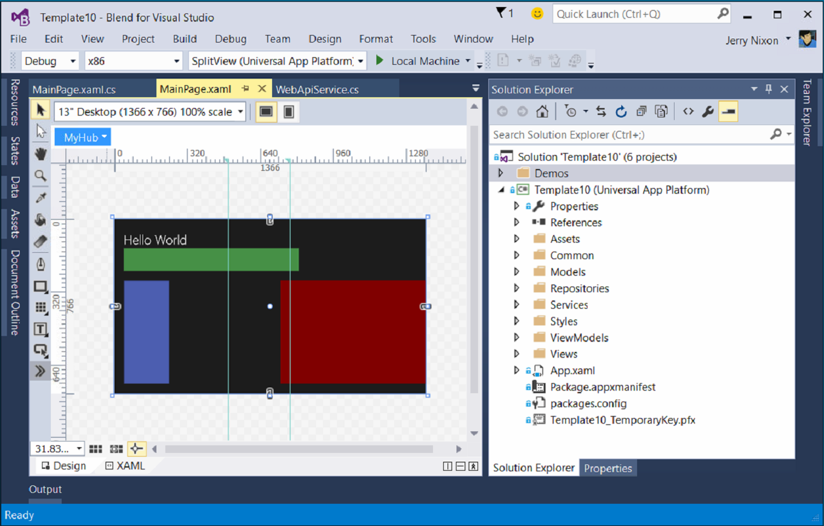
Blend for Visual Studio
The XAML Developer’s IDE
Always part of Visual Studio
Uses the Visual Studio shell
Full auto-complete & intellisense
Validation
Snippets
Peek
File & solution management
Resource management
Data management
Animation
States

Slide 38
Visual Studio 2015 Editions
Enterprise
Architecture Modeling, Diagnostics, VSO/ALM & Release Management
Professional
Architecture Validation, VSO/ALM & Feedback Management
Community Editions
Visual Studio Professional Edition

Slide 39
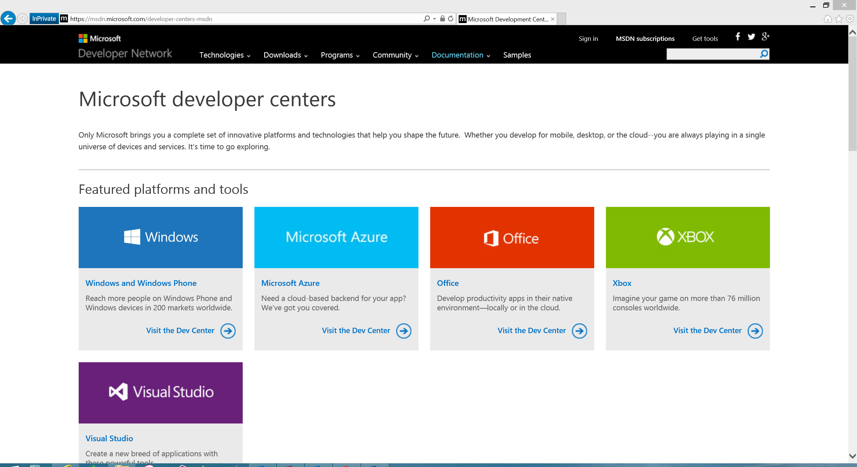
Microsoft Developer Network
Microsoft documentation
http://msdn.Microsoft.com
http://dev.Windows.com
Microsoft training
http://msevents.Microsoft.com
http://MicrosoftVirtualAcademy.com
MSDN Subscription
Operating Systems
Server/Client Products
Developer Tools
Azure/O365 Credits

Slide 40
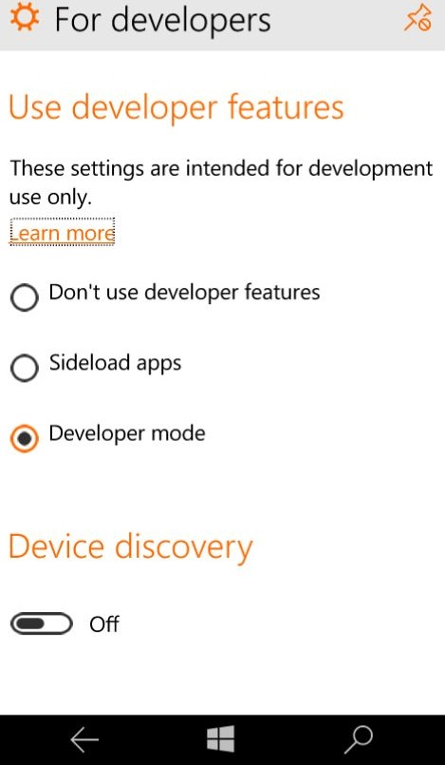
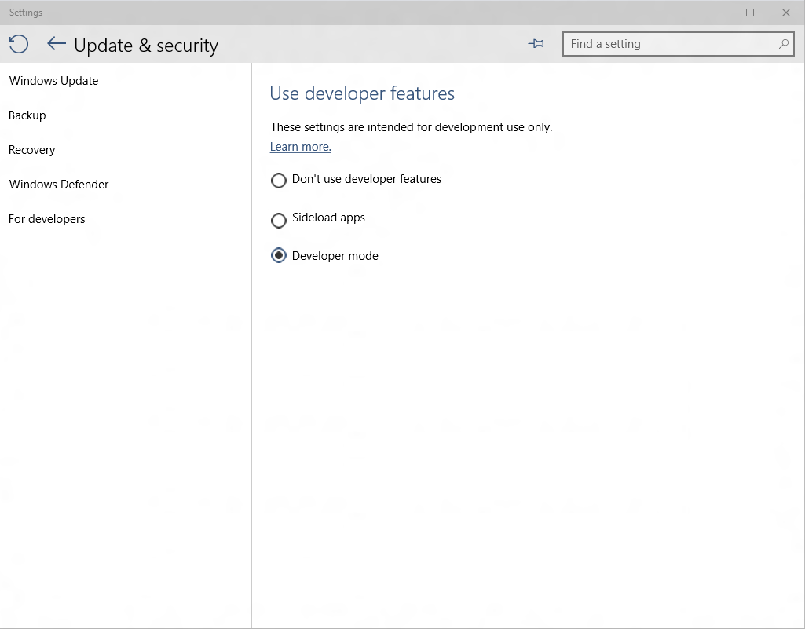
Developer unlock

Slide 41

Where can I develop?
Windows 10
Requires Visual Studio 2015
Windows 8.1 & Windows Server 2012 R2
The Visual Studio designer does not function
Debugging requires a Windows 10 device or Remote Debugging Tools

Slide 42
Managed languages are more efficient than ever

Slide 43
.NET Native
Next generation compiler in the cloud
Every Windows apps, only Windows app (right now)
Apps use the standard C++ optimizer
As optimizer performance improves, so does .Net native
Apps with .Net bootstrapper
Includes garbage collection
There is no runtime
This is machine code

Slide 44
Every Windows app will be compiled with .Net Native

Slide 45
Real benefits with .Net Native
50% faster average startup time
14% less average memory usage

Slide 46
.Net Native enables the platform to update at a faster cadence

Slide 47
Introducing “Template 10”
A new blank template
Includes a few files & empty folders to guide conventions
Similar to the MVC template
Add-on components to solve common problems
Solving for the 90%
The code will solve the 90% use case
Delivering with Windows 10
The template is in GitHub and still under construction

Slide 48
Contribute to Template10 http://aka.ms/template10

Slide 49
A single platform
One Windows
Many devices
Developer experience
Windows tooling
.Net Native
Template 10
http://aka.ms/template10

Slide 51

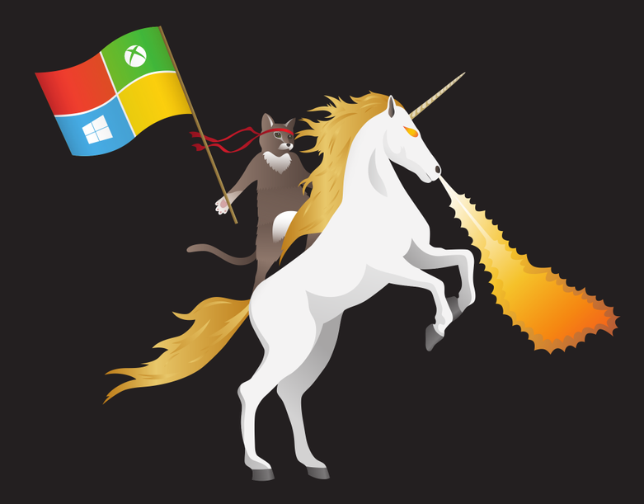
Windows 10 for Developers: What’s New in Universal Apps and Visual Studio 2015
Nick Landry Microsoft Senior Technical Evangelist nick.landry@microsoft.com
Blog: AgeofMobility.com
@ActiveNick

Slide 52
Windows 10 for Developers: What’s New in Universal Apps and Visual Studio 2015
DevIntersection
Scottsdale, AZ
Nick Landry Senior Technical Evangelist – NY Metro
AgeofMobility.com
github.com/ActiveNick
@ActiveNick

Slide 53
Agenda
Recap of Key Announcements from BUILD 2015
Introduction to Universal Windows Platform
Universal Windows Tooling
Migrating Apps from Windows 8.1
Windows 10 App Model
Q&A

Slide 54

Visual Studio 2015 RC with Universal Windows App Development Tools
Download Now!!!
Install latest Windows 10 OS Preview
insider.windows.com
Install VS 2015 RC w/ Universal Windows SDK & Tools
www.visualstudio.com
Build your first Universal Windows App

Slide 55
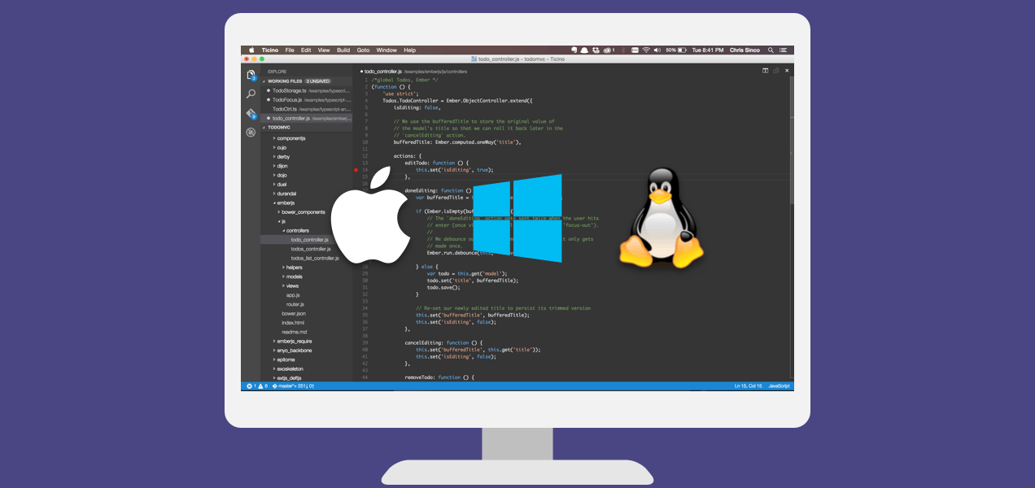
Visual Studio Code
Build and debug modern web and cloud applications.
Code is free and available on your favorite platform:
Linux, Mac OSX, and Windows.
C#, TypeScript, JavaScript, HTML, CSS, LESS, SASS, Python, JSON, CoffeeScript, Ruby, Jade, Clojure, Java, C++, R, Go, makefile, shell, powershell, bat, XML, Markdown
http://code.visualstudio.com

Slide 56
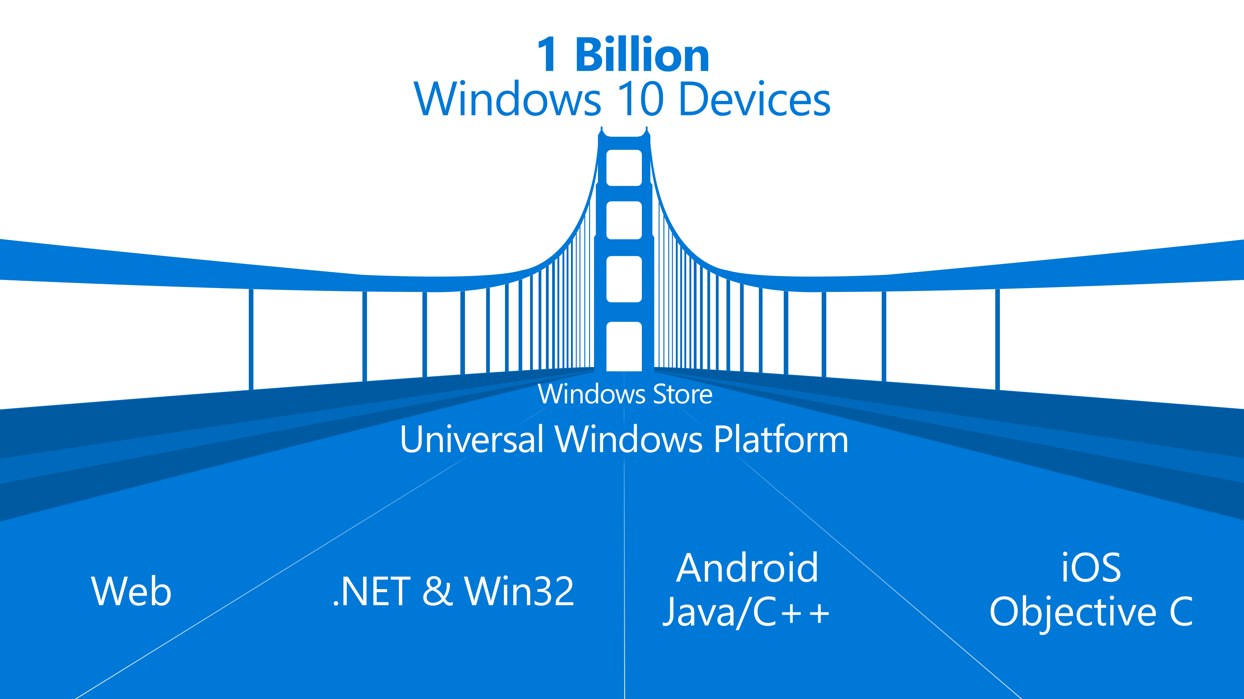

Slide 57
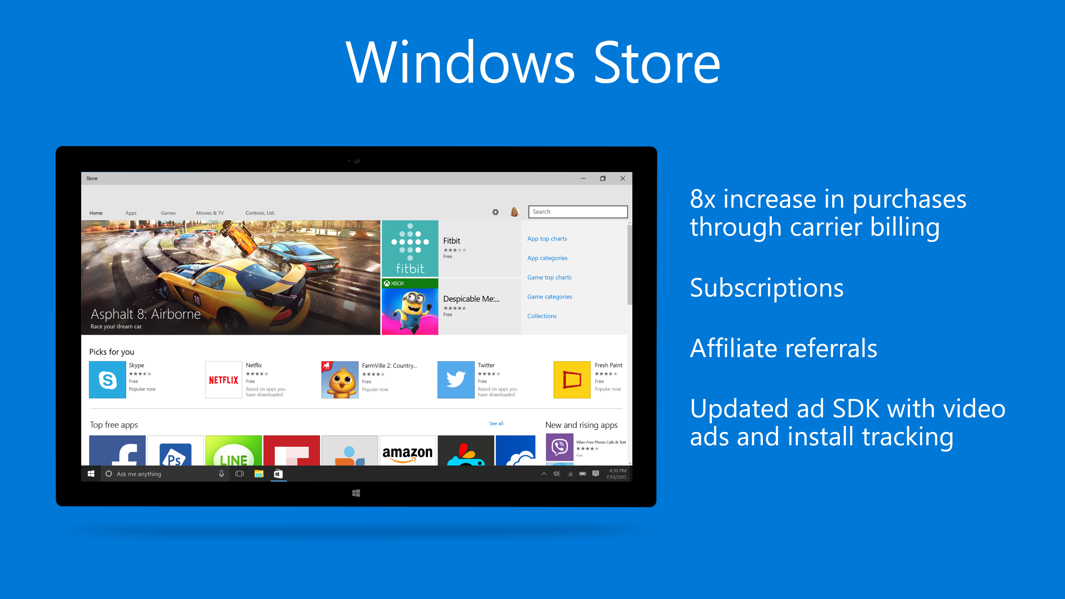

Slide 58

Windows Continuum

Slide 59
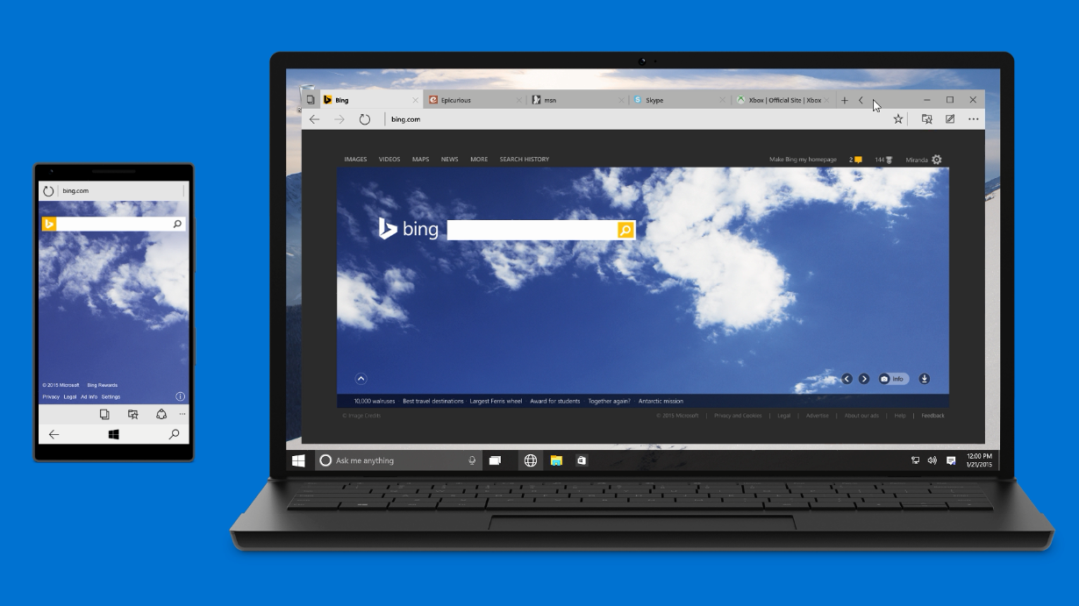
Microsoft Edge
Aka “Project Spartan”
Only browser with Cortana, to get more done on the web
Distraction-free, offline reading
Built-in note-taking & sharing

Slide 60
Azure @ BUILD 2015
Azure SDK 2.6 for .NET
SQL Database Enhancements
Azure Data Lake
Azure SQL Data Warehouse
Azure Service Fabric
Azure App Service Environment (Premium)
Azure Resource Manager Support for VMs, Storage and Networking
Azure Marketplace Enhancements
And much more: http://azure.microsoft.com/blog
Notes:
http://azure.microsoft.com/blog/2015/04/29/azure-peaks-in-the-valley-new-features-and-innovation/

Slide 61

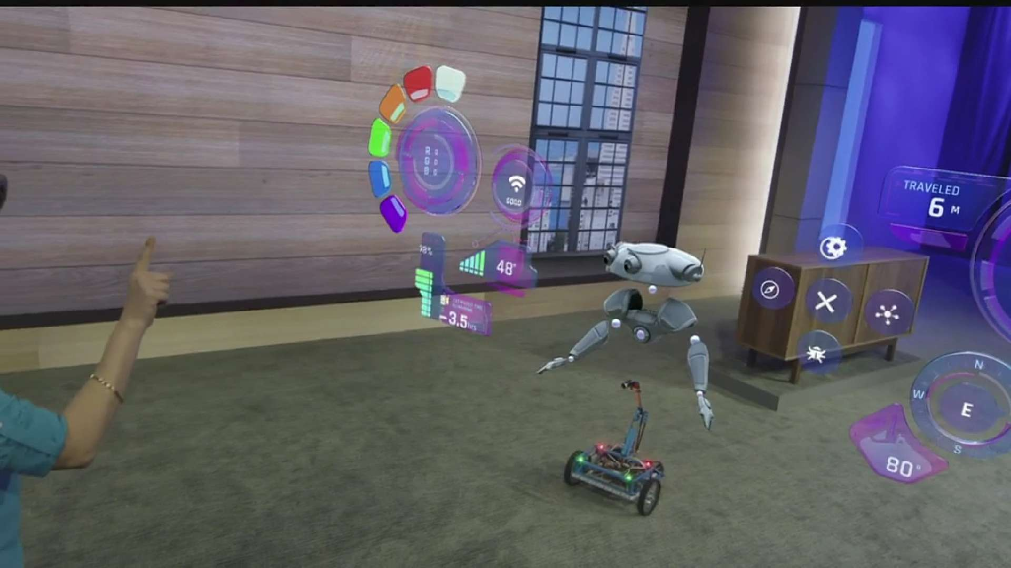
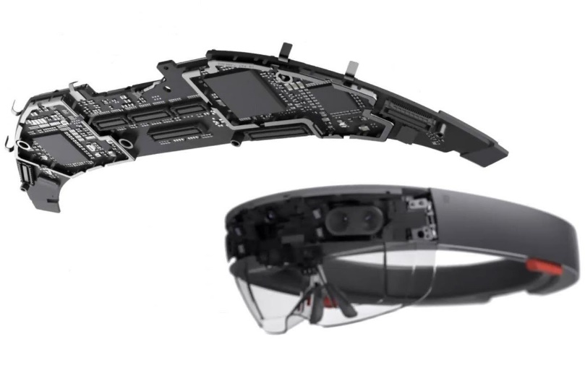
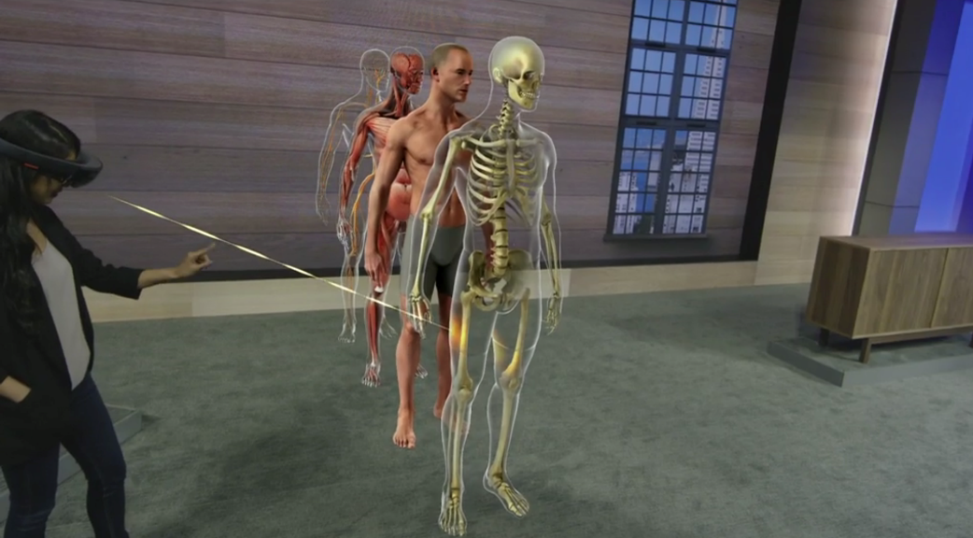
microsoft.com/hololens

Slide 62

Watch all sessions on demand at
http://channel9.msdn.com/events/build/2015
Notes:
Visual Studio Code
Makers: Windows 10 IoT Core Insider Preview
New partnerships announced: Arduino, Hackster.io
And much more…

Slide 63
The Convergence Journey
Xbox 360
Xbox One
Unified core and app platform
Converged
OS kernel
Windows 8.1
Windows 8
Converged
app model
Windows 10
Windows Phone 8.1
Windows Phone 8
Easy for users to get & stay current
Windows Phone 7.5
Windows on Devices

Slide 64
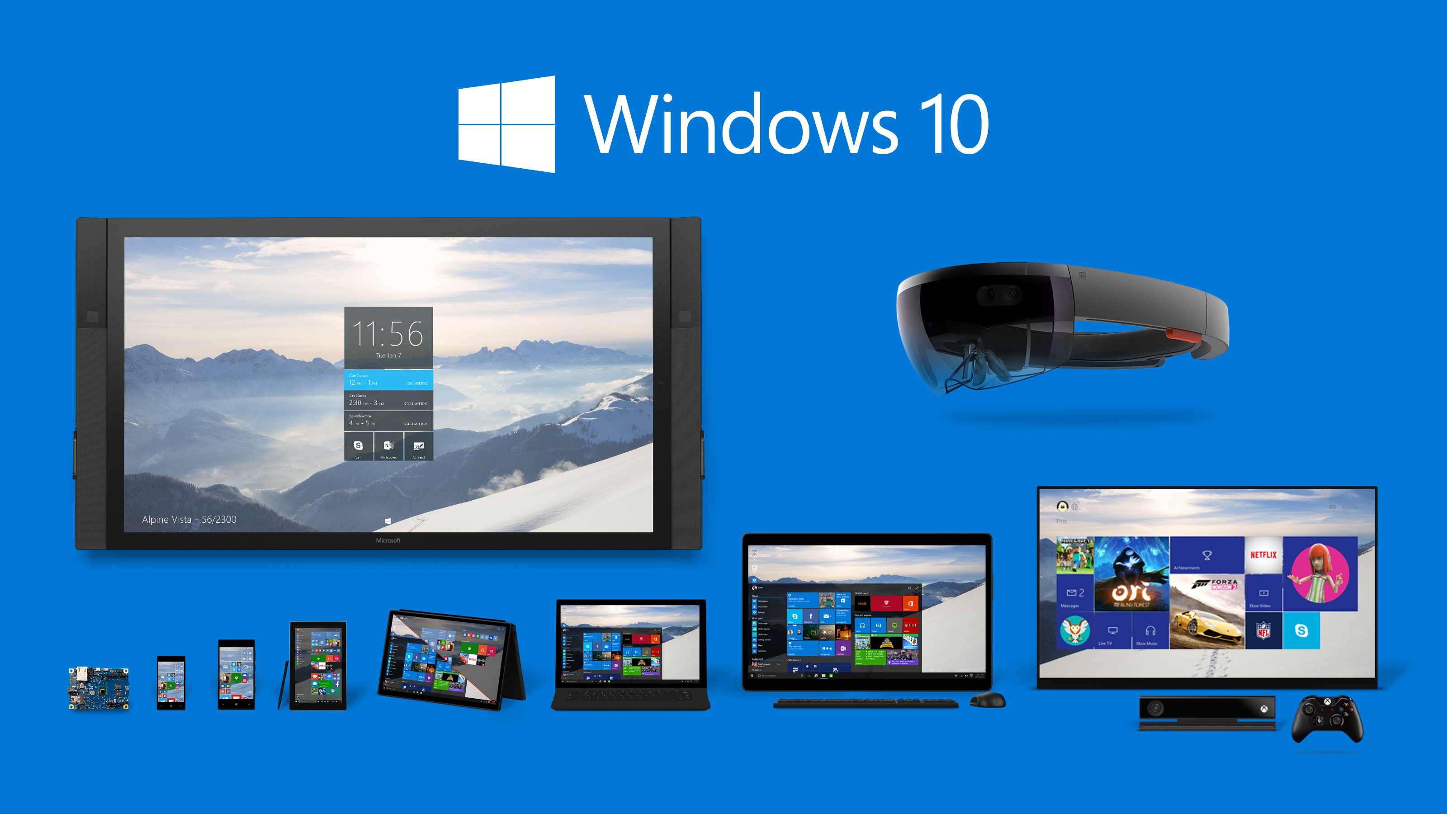

Slide 65
Universal Windows Platform
Mobile
Desktop
Unified Developer Platform
Single Application Package
Adaptive Code
Universal Windows Platform
Core APIs
IoT
Xbox
Holographic
Surface Hub

Slide 66

Universal Windows Platform
Wherever your code was born, you can bring it to Windows
Windows Platform
Web Platform
Universal Windows 8 Apps (C++/C#/JS)
Microsoft Edge HTML Engine
Universal Windows 10 Apps (C++/C#/JS)
Surface Hub
Desktop
Cordova Tooling (HTML/JS)
Project Centennial (Classic Apps)
Hosted Web Apps (HTML/JS)
Universal Windows Platform
IoT
Xbox
Middleware Platforms
Other Mobile Platforms
Middleware Partners (e.g., Xamarin)
Holographic
Mobile
Project Astoria (Java/C++)
Game Engine Partners (e.g., Unity)
Project Islandwood (Objective C/C++)

Slide 67
Getting Started
Building apps for the Universal Windows Platform (UWP)

Slide 68
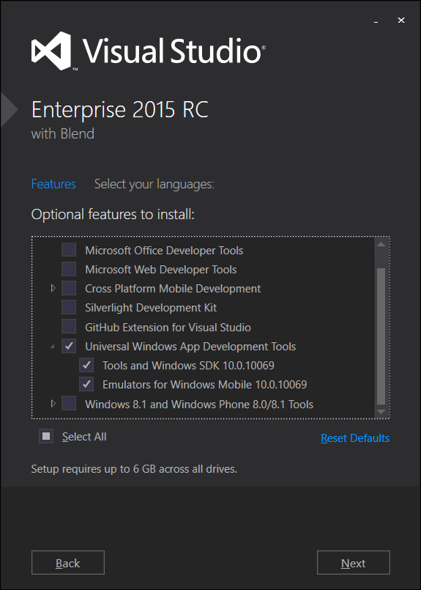
Acquiring Windows 10 Tools/SDKs/Emulators
Select “Universal Windows App Development Tools” using Custom setup option

Slide 69
Supported OS for Universal Windows development
Windows 8.1
Windows 10
Windows Server 2012 R2
*Windows 7
Best developer experience for building Universal Windows apps
Deploy/Debug/Profile options:
Simulator
Local Machine
Mobile Emulators
Remote Machine
Device
XAML Designer/Intellisense
All other features work at parity with Windows 10, except:
Deploy/Debug/Profile options:
Mobile Emulators
Remote Machine
Device
XAML Intellisense only
No WACK (Server R2)
All other features work at parity with Windows 10, except:
Deploy/Debug/Profile options:
Remote Machine
Device
XAML Intellisense only
*will be supported at RTM

Slide 70
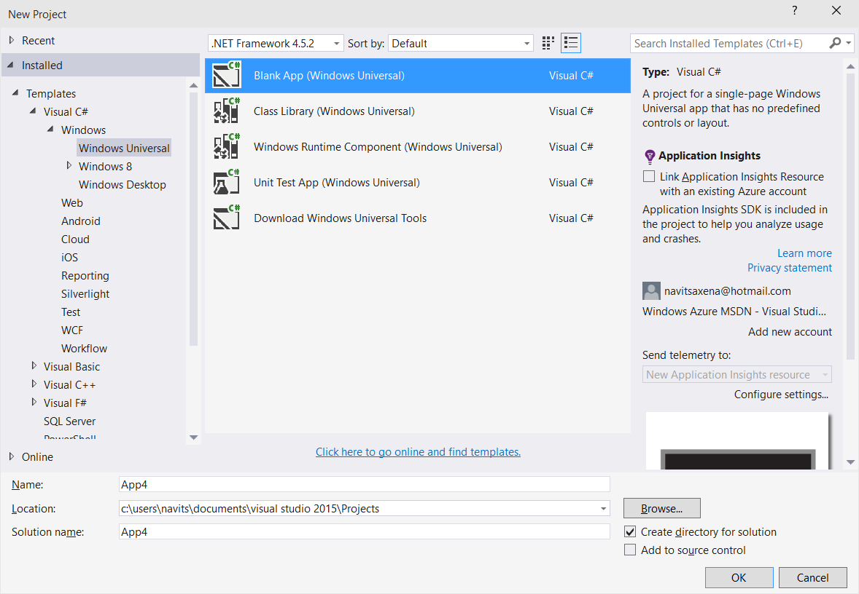
Project Templates

Slide 71
Universal Windows Samples
https://github.com/Microsoft/Windows-universal-samples

Slide 72
Multiple Adaptive Dimensions
Version adaptive
App runs on a base OS version but can use up-level APIs
Device family adaptive
App uses device family-specific APIs when running on such a device
Form factor adaptive aka responsive layout
App provides user-interface tailored to one or more specific form factors
Not discussed here

Slide 73
Why build a version adaptive app?
Windows is shipping on a more frequent cadence
Developers have access to new APIs more frequently
When building an app, do you
Target a release with most market share (typically, an older release)?
Target a release with the latest features (typically, the newest release)?
Considerations: End users typically run latest; enterprises will be slower to adopt
Version adaptive apps provide best of both:
Target the release with the most market share but also run on later releases and use their new features

Slide 74
Why build a Device Family adaptive app?
Your app runs on more types of devices, you have a larger potential market
Challenges for Microsoft:
Make it as easy as possible for a developer to create an app that can run across device families
Ship a (nearly) identical programming surface for all Device Families
e.g. Desktop, Mobile, Xbox, HoloLens, …
What about the differences?
Questions developers ask:
How limiting is it to write to the “least common denominator” API?
How hard is it to take advantage of Device Family-unique APIs, when available?

Slide 75
Summary: Adaptive Applications
Run on multiple Windows versions & device families
Conditionally use functionality when its available
Traditionally, adaptive applications are more difficult to write
Goal: Make developing adaptive applications easier!

Slide 76
Goal: Building a universal adaptive app
Best to use a single body of source code
Mechanics
Build for all CPU architectures
Tooling makes this easy to do
Write code that works on all Device Families
Easy with a common universal API
Handle the special case for APIs that are not universal
“… ay, there’s the rub!”

Slide 77
Make it easy to write an adaptive app
Ensure most APIs are present on all Device Families
For Windows 10, > 85% of WinRT APIs are common
96.2% of the APIs used by the top 1000 apps are common
API always present; API sometimes present

Slide 78
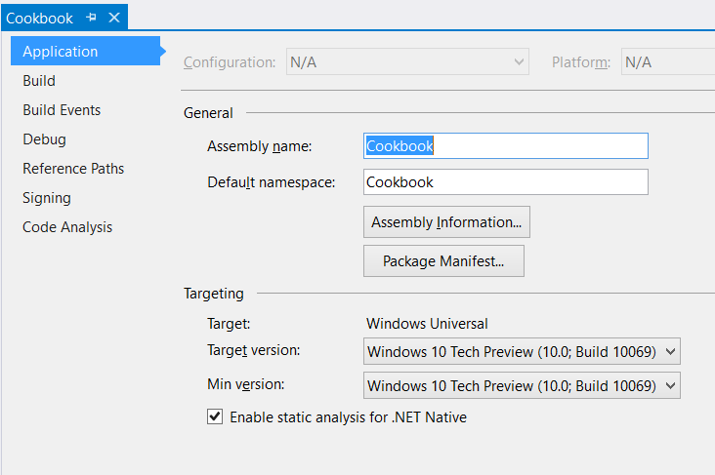
Project Properties
Target version (TargetPlatformVersion)
Defines the version of Universal Windows SDK being targeted by project
Defines the available API surface for the application
Is stamped as TargetDeviceFamily.MaxVersionTested property in the AppX manifest file as part of the build process
<Dependencies>
<TargetDeviceFamily
Name="Windows.Universal" MinVersion="10.0.10069.0" MaxVersionTested="10.0.10069.0" />
</Dependencies>

Slide 79
Project Properties
Min version (TargetPlatformMinVersion)
Defines the minimum version of Universal Windows platform being supported by the project (adaptive application package)
Is stamped as TargetDeviceFamily.MinVersion property in the AppX manifest as part of the build process
<Dependencies>
<TargetDeviceFamily
Name="Windows.Universal" MinVersion="10.0.10069.0" MaxVersionTested="10.0.10069.0" />
</Dependencies>

Slide 80
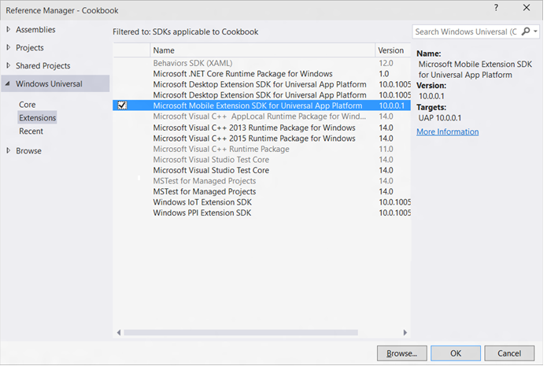
Windows Device Family Extension SDKs
Use device family specific APIs by adding references to Windows Device Family Extension SDKs

Slide 81
Adaptive Code
Use Windows.Foundation.Metadata.ApiInformation APIs to write adaptive code across different Universal Windows versions or different target device families
if (Windows.Foundation.Metadata.ApiInformation.IsTypePresent
("Windows.Phone.UI.HardwareButtons"))
{
Windows.Phone.UI.Input.HardwareButtons.BackPressed += HardwareButtons_BackPressed;
}
Code | Title | Speaker
679 | From the Small Screen to the Big Screen: Building Universal Windows App Experiences with XAML | Tim Heuer Harini Kannan

Slide 82
3rd Party Extension SDKs
Developers can reference Windows 8.1 Extension SDKs in a Universal Windows app
Referencing a native Windows 8.1 Extension SDK requires referencing “Microsoft Visual C++ 2013 Runtime Package for Windows Universal” SDK
Developers can build Extension SDKs for Universal Windows platform and write adaptive code against platform APIs
Universal Windows Extension SDKs are installed under:
\Program Files\Microsoft SDKs\Windows Kits\10\ExtensionSDKs

Slide 83
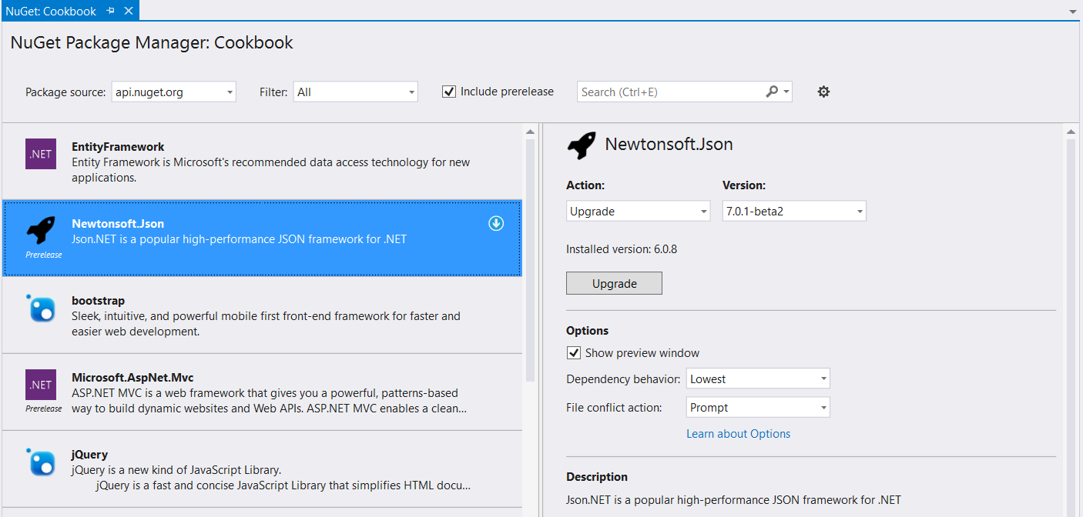
NuGet
Universal Windows apps support referencing Windows 8.1 NuGet packages

Slide 84
NuGet – RTM
Universal Windows apps will support referencing Windows Phone 8.1 NuGet packages
Developers will be able to author NuGet packages specific to Universal Windows platform
If you want an early preview of NuGet bits for Universal Windows platform, send an email to: navits@microsoft.com

Slide 85
App Insights
App Insights enable developers to monitor app’s performance and usage statistics
Universal Windows project templates are enabled for App Insights and monitors app users, sessions, page view, crashes and real time usage without writing any additional code
Developers can easily add custom events to collect additional telemetry data for the app

Slide 86
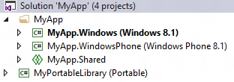

Universal 8.1 App
Upgrade Windows/Windows Phone 8.1 projects
Add single Universal Windows project to target different Windows 10 devices
Use Adaptive code for device family specific APIs
Use Adaptive UI to support different form factors
Use Shared projects, WinRT components, PCLs to share code between Universal Windows, Windows 8.1 and WP 8.1 projects
1: Single Universal Windows Project

Slide 87

Universal 8.1 App
Add a new Universal Windows project to target a specific Windows 10 device (ex: Mobile)
Update Package.appxmanifest to include “Windows.Mobile” device family with matching MinVersion/MaxVersionTested
<Dependencies>
<TargetDeviceFamily
Name="Windows.Mobile"
MinVersion=“<Windows.Mobile MinVersion>“
MaxVersionTested=“<Windows.Mobile MaxVersionTested>"/>
</Dependencies>
Add a new Universal Windows project to target other Windows 10 devices
Use Shared projects, WinRT components, PCLs to share code between Universal Windows, Windows 8.1 and WP 8.1 projects
2: Different project/package for a device family

Slide 88
App Model
Why do we need an app model?
What is the Windows App Model?

Slide 89
Why do we need an app model?
Windows has never had a definition of an app
You know it when you see it but it’s never written down
Started with .exe but…
How do you install it?
How do you store state?
How long does the app run for?
What’s the versioning story?
How do you integrate with the OS?
How do you integrate with other apps?
What can your app do?
The Windows App Model provides answers to these questions

Slide 90
What is the Windows App Model
Defines the app lifecyle
Unified across all Windows devices
Scales from IOT→Mobile→PC→Xbox→Hololens
Cradle to Grave
Install
Runtime environment
Resource Management
Update
Data Model
Uninstall

Slide 91
Windows App Model
Inclusive of all apps that run on Windows
Universal Windows Apps
Existing apps
Phone Apps
Modern Apps
Classic Windows Apps

Slide 92
What does the app model mean?
AppX is the deployment model
Putting MSI on notice
Provides a better way to install/uninstall/update
Runtime “virtualizes” registry/disk access
Enforces App Model Policy
Integrate into the new app model

Slide 93
Windows Desktop App Model Policy
Allowed
Full API access
Existing Desktop app lifecycle
Denied
System components
Drivers – user or kernel mode
NT Services
Admin elevation
InProc extensibility
E.g. Shell Extensions,
Can harm the integrity of the system
Security / stability issues
Can render the system unusable

Slide 94
Getting your app
User promise:
Never regret installing an app
Where do I get the app from?
Store is the default place to get apps
Flexible deployment
Based on the phone model
Token enrolled on device then any app signed with that token can be installed from anywhere
AppX improvements
Size – support >150Gb

Slide 95


Developer Unlock
Cutting the cord!
Now just a setting on device
Registry key that can be controlled by enterprise
Limits
Phone: 20 apps
PC: Unlimited

Slide 96
Running your code
Windows will run all your modern apps
XAML, WWA, Silverlight
Existing apps will run on the platforms they were built on
 | Windows | Windows Mobile
Universal Windows Apps | ✓ | ✓
Classic Windows Apps | ✓ | X
Windows Phone 7.x, 8.0, 8.1 apps | X | ✓
Existing Windows Store Apps (WinRT) | ✓ | X

Slide 97
Multitasking
Resource Management
Scaling from low end phones to high end PCs
Extended Execution for foreground applications
Task completion scenarios
let me finish saving my file
Turn by turn navigation
Ask for more time
The amount of time is based on what device you’re running on
Always keep my app running
Tell the OS when you start that you intend to keep running
Triggers

Slide 98
App Resume policy
All UWP apps will resume be default
All 8.1 Phone apps and 8.0/8.1 Desktop apps also resume
Windows Phone 7.x and 8.0 apps do *not*
Why?
App Compatibility

Slide 99
What does this mean for your app?
Basically 2 models
Always resume the experience
Navigate back to home
Both are good models
Which should you choose?
Depends on your use model

Slide 100
App Integration
Apps have traditionally on mobile devices been isolated
Isolation is good but…
Users want to get things done
What did the web teach us?
URL based activation/app model allows for apps to integrate easily
Keep it simple
Build it and let the ecosystem flourish
What did COM teach us?
Build it and let the ecosystem flourish
Complexity kills

Slide 101
Building a Web of Apps
Allow apps to integrate using the best of the web
URL based activation/communication
Foreground to Foreground
Very similar to the web model
Allows for custom scheme invocation skype:andrewclinick
New in 10: the ability to return results, query for apps and enumerate apps
Foreground to Background
Application services
Enables you to “publish” a background task that can be called by other apps
Facebook & Twitter integration with the People app is a key example of this

Slide 102
App 2 App/App Services and 1st party apps
Using our own technology was a key feature for 10
Cortana and People app use app services extensively
People: Social Network Extensibility
Cortana: Voice Commands on Cortana’s canvas
Office & Skype: Meeting requests
Interactive Toasts: User input/controls in toasts
Photos: Photo Editors
Camera: Lenses

Slide 103
Example: Viber integration with Cortana
Define the app services in the appmanifest
Register the Voice Command Definition file with Cortana
In package.appxManifest
<Extensions>
<uap:Extension Category="windows.appService" EntryPoint="ViberServices.ViberVoiceCommandService">
<uap:AppService Name="ViberVoiceServiceEndpoint" />
</uap:Extension>
</Extensions>
In viber.vcd
<Command Name="SendMessage">
<Example> Tell Mark to buy ink and paper </Example>
<ListenFor RequireAppName="BeforeOrAfterPhrase"> Tell {contact} [to] {message} </ListenFor>
<VoiceCommandService Target="ViberVoiceServiceEndpoint"/>
</Command>

Slide 104
Recap & Call to Action
The Windows convergence is finally here: Start building today
Windows 10 = New opportunities
Join the Windows Insider program
Download Visual Studio 2015 RC
Download Universal Windows Samples
Learn about the Universal Windows Platform and the Windows 10 App Model
Bring your current code and apps to Windows 10
GO BUILD SOMETHING!!!

Slide 105

is coming this summer!
Windows 10 Developer Tools Preview now available
http://aka.ms/win10toolspreview
Build 2015 Conference – Watch On-Demand
Watch Online at http://channel9.msdn.com/events/build/2015
A Developer's Guide to Windows 10 Preview
Free MVA Course: http://aka.ms/win10devpreviewmva
New live events will be recorded May 19-21, 2015
Windows 10 January Briefing
Cortana, Phones, Xbox Streaming, HoloLens, oh my!
Replay On-Demand: http://news.microsoft.com/windows10story

Slide 106
Windows 10 Developer Resources
Windows 10 Samples https://github.com/Microsoft/Windows-universal-samples
Developer Assistant for Visual Studio http://aka.ms/devassistant

Slide 107
Watch Related BUILD 2015 Sessions
Code | Title | Speaker
650 | Developing Universal Windows Apps in Visual Studio 2015 | Navit Saxena
749 | Deep dive into XAML & .NET Universal Windows app development | Unni Ravindranathan
697 | New XAML Tools in Visual Studio 2015 | Unni Ravindranathan
719 | Fast and Powerful Diagnostics, and Problem Solving with Application Insights | Victor Mushkatin
617 | Introducing the App Model for the Universal Windows Platform (UWP) | Andrew Clinick Matt Hidinger
629 | What's New in XAML for Universal Windows Apps | Joe Stegman
679 | From the Small Screen to the Big Screen: Building Universal Windows App Experiences with XAML | Tim Heuer Harini Kannan
741 | Moving to the Universal Windows Platform: Porting an App from Windows 8.1 XAML or Windows Phone Silverlight to Windows 10 | Sam Jarawan
733 | API Contracts (or How I Learned to Stop Checking OS Versions and Love Feature Detection) | Brent Rector

Slide 108


Visual Studio Community Edition
Mobile App Development:
Universal Windows apps for Windows Phone & Windows tablets, hybrids, laptops & desktops
Mobile Hybrid apps with Cordova
Mobile Web apps with HTML5 & JavaScript
Native iOS & Android apps with Xamarin
Web Applications: ASP.NET, HTML5, SPAs, Python, support for 100% client-side JavaScript frameworks
Cloud Development with Azure in .NET or Node
The best Integrated Development Environment (IDE) for…
Mobile, Web, Cross-Platform,
Cloud, Games, Open Source,
Hardware/IoT, , Desktop, etc.
http://aka.ms/vsc2013
C# Scripting Editor for Unity Games
Arduino Sketches, .NET Micro Framework, IoT, etc.
Windows Desktop apps, Office apps, C#, C++, VB, F#, JavaScript, Node, Python, Ruby, and more…

Slide 109


Online Microsoft training delivered by experts to help technologists continually learn
Hundreds of courses for developers, IT Pros, students, entrepreneurs and enthusiasts
11 different languages
3M students registered
Build your own Learning Plan
All free!
http://www.microsoftvirtualacademy.com

Slide 110


My MVA Course Online
Universal Windows App Development with Cortana and the Speech SDK
01 | Introducing Cortana & Getting Started with Speech
02 | Using Speech Synthesis in Mobile Apps
03 | Cortana Integration & Voice Commands
04 | Speech Recognition in Apps
05 | Designing Apps with Speech
06 | Advanced Speech Topics
Available for on-demand viewing now:
Microsoft Virtual Academy: http://aka.ms/CortanaMVA

Slide 111
Technical Resources for Windows Devs
Visual Studio Community Edition (free): http://aka.ms/vsc2013
Ultimate Guide & FAQ to Setting-up a Windows Phone Dev Environment: http://aka.ms/wpdevsetup
Building Apps for Windows Blog: http://blogs.windows.com/buildingapps
Dvlup Challenges & Rewards: www.dvlup.com
Microsoft App Studio: http://appstudio.windows.com
Nick Landry’s Blog: www.AgeofMobility.com
Windows Phone Developer Magazine (online): http://flip.it/95YFG
Windows Phone 8.1 Jump Start Training: http://aka.ms/wp81js
Windows 8.1 Universal Apps Samples Pack https://code.msdn.microsoft.com/windowsapps/Universal-Windows-app-cb3248c3

Slide 112
Technical Resources for Cloud Devs
Get started with a free Azure trial and get $200 to spend for 30 days: http://aka.ms/trymsazure
Microsoft Azure Management Portal: https://manage.windowsazure.com
Microsoft Azure New Preview Portal: https://portal.azure.com/
Microsoft Azure Cloud Cover Show: http://channel9.msdn.com/Shows/Cloud+Cover
Azure Friday: http://friday.azure.com
AzureChatr App Sample with Push for Windows, iOS & Android: http://aka.ms/azurechatrblog
Visual Studio Community Edition (free): http://aka.ms/vsc2013

Slide 113

Thank You!
Slides are in SlideShare. Demos are on GitHub.
Contact me and let me know what you build, I will be happy to help promote your apps.
Blog: www.AgeofMobility.com
Twitter: @ActiveNick
Email: nick.landry@microsoft.com
Mobile Apps: www.bigbaldapps.com
LinkedIn: www.linkedin.com/in/activenick
GitHub: github.com/ActiveNick
Slideshare: www.slideshare.net/ActiveNick

